Slide 1

Regression Modelling Intro to R

Slide 2
Outline
Overview
Linear regression
Assumptions and model fit
Logistic regression
Model fit
Multinomial logistic regression
Poisson regression
Time-to-event/ Survival analysis

Slide 3

Regression Modelling
Regression modelling aims to identify which variables impact an outcome of interest.
We can use this:
To understand relationships
To perform predictions
Intercept
Covariate
Response
Error

Slide 4
What type of outcome are you interested in?
Outcome
Continuous
Ex. SBP
Categorical
Ex. MI (Y/N) or Deprivation (1-5)
Count
Ex. # of MIs
Time-to-event
Ex. Death, MI (Years)
2 categories
>2 categories
Regression
Linear
Logistic
Multinomial Logistic
Poisson
Kaplan-Meier*
Ordinal Logistic
Cox P-H
Parametric
* Not regression but worth learning

Slide 5
Question
This is an example of:
Multivariable Logistic Regression
Multivariate Logistic Regression
Multivariable Linear Regression
Multivariate Linear Regression
None of the above

Slide 6
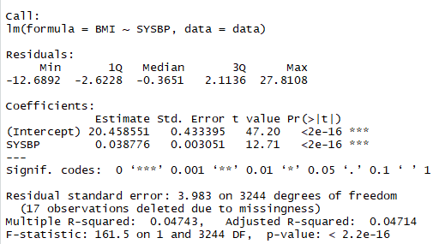
Regression Modelling in R
R provides:
Estimates of the regression coefficients
Tests of association between response and covariate.
Model fit and residuals
If you would like to follow along with the code, please
install.packages(c("stats", "ResourceSelection", "pROC", "nnet", "survival", "survminer"))
pack ← c("stats", "ResourceSelection", "pROC", "nnet", "survival", "survminer")
lapply(pack, require, character.only = TRUE)

Slide 7
Linear Regression: Code
General Structure
model_object <- lm(outcome ~ pred1 + pred2 + pred3, data = your data)
Example
model_lin <- lm(SYSBP ~ SEX + AGE + PREVMI, data = data1)
The model is now saved as an object called model_lin

Slide 8
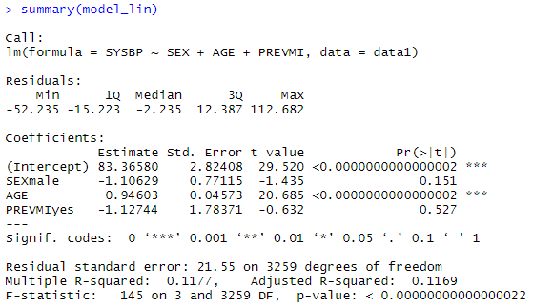
Linear Regression: Code
General Structure
model_object – this will display only the coefficients
summary(model_object) – this will display the coefficients, statistical tests and model diagnostics
Example
summary(model_lin)

Slide 9
Linear Regression: Assumptions
Linearity: The relationship between the outcome and the predictor(s) is linear or should lie on a straight line.
Homoscedasticity: The spread of the data around the line should be constant (equal variance).
Independence: Observations should be independent of each other.
Normality: The data should be normally scattered around a straight line.

Slide 10
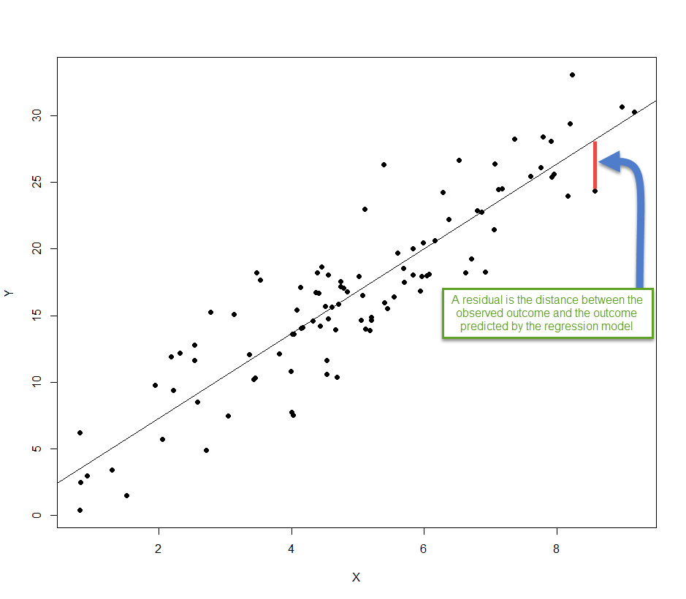
Linear Regression: Assumptions
Residuals can be used to assess
Homoscedasticity (equal variance)
Linearity
Normality

Slide 11
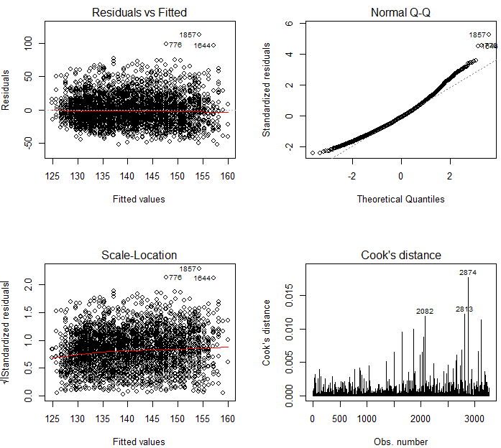
Linear Regression: Assumptions
General Structure
par(mfrow=c(nrows, ncols) -- displays multiple plots
plot(model_object, which = 1:4) -- will plot 4 plots
Example
par(mfrow = c(2,2))
plot(model_lin, which = 1:4) = 1:

Slide 12
Linear Regression: Variable Selection
Analysis of Variance (ANOVA) tests whether a more comprehensive model is superior.
We can test multiple models to determine “important” predictors.
The Akaike information criterion (AIC) is a relative measure of goodness-of-fit that penalizes additional model parameters that can lead to over-fitting
From a set of different models, the “best” model is the one that minimizes AIC.
The Bayesian information criterion (BIC) is similar.

Slide 13
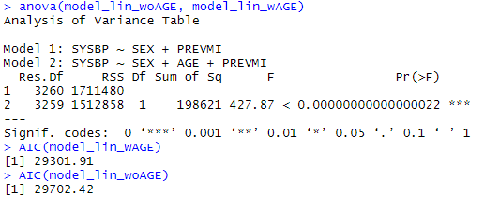
Linear Regression: Variable Selection
General Structure
AIC(model_object_w_CovOfInt)
anova(model_object_wo_CovOfInt, model_object_w_CovOfInt)
Example
model_lin_wAGE <- lm(SYSBP ~ SEX + AGE + PREVMI, data = data1)
model_lin_woAGE <- lm(SYSBP ~ SEX + PREVMI, data = data1)
anova(model_lin_woAGE, model_lin_wAGE)
AIC(model_lin_wAGE)
AIC(model_lin_woAGE):

Slide 14
Question
True or False?
Generally speaking, when comparing two models,
the model with the lower AIC is the better model.

Slide 15
Generalized Linear Models
A more flexible form of Linear Models that are used when data are non-normal
They have many applications including:
Binary outcomes
Count data
Categorical outcomes with >2 categories
Ordered, categorical outcomes with >2 categories
Skewed outcomes or outcomes that is not normally distributed
The GLM function in R uses a family and a link function to specify the distribution

Slide 16
GLM: Commonly Used Family and Link Functions
Regression | Family | Default Link
Logistic | binomial | “logit” | Estimate probability of event
Linear | gaussian | “identity” | Estimate mean cost with “log” or “identity” link
Poisson | poisson | “log” | Estimate rate of event
If not specified, R will use the family’s default link function
You’ll notice that you can also use GLM to run a simple linear regression

Slide 17
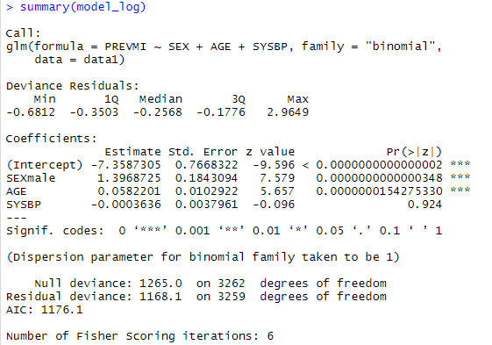
GLM: Logistic Regression Code
General Structure
glm(outcome ~ pred1 + pred2 + pred3,
family = “binomial”, data = your data)
Example
model_log <- glm(PREVMI ~ SEX + AGE + SYSBP,
family = “binomial”,
data = data1)
summary(model_log)

Slide 18
GLM: Goodness of Fit
The Hosmer-Lemeshow test tests goodness of fit for logistic regression models.
It tests whether the observed event probabilities match the predicted event probabilities.
Receiver operating characteristic (ROC) curves are also used to test goodness-of-fit for logistic regression.
An ROC curve plots the true positive rate against the false positive rate for the different thresholds of a diagnostic test.
The area under an ROC curve (AUC) is a measure of goodness-of-fit.

Slide 19
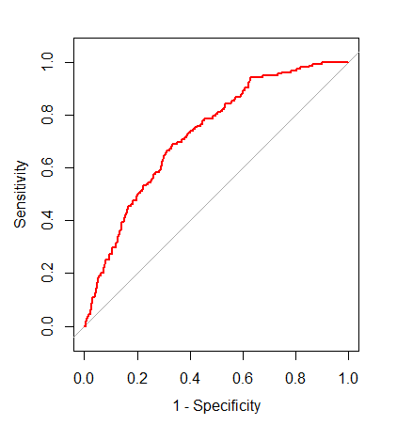
GLM: Goodness of Fit Code
General Structure
hoslem.test(observed_outcomes, expected_outcomes, g = 10)
Roc1<- roc(observed_outcomes, expected_outcomes)
plot(roc1, col = 'red', legacy.axes = TRUE)
auc(roc1)
Example
hoslem.test(data$PREVMI, fitted(model_log), g = 10)
roc1 <- roc(data$PREVMI, fitted(model_log))
plot(roc1, col = 'red', legacy.axes = TRUE)
auc(roc1)

Slide 20
Variable Selection: Stepwise Methods
Stepwise forward regression:
Create a set of potential predictors
One by one create a model with the “best” predictors
“Best” predictors are based on statistical criteria (ANOVA or AIC)
Progress until the model cannot be improving by adding another predictor
Stepwise backward regression:
Create a full model with all potential predictors
One by one remove predictors with “no predictive effect”
“No predictive effect” is assessed statistically.
Progress until all predictors have a predictive effect.
Stepwise regression
Combination of stepwise forward and backward regression

Slide 21
Variable Selection: Suggestions
Stepwise regression has been criticized.
Variable selection methods should take into account:
Your research question
The background of your study
Your study design
The structure of your dataset
The variables in your dataset
The (clinical) literature

Slide 22
Multinomial Logistic Regression
Used when you have an outcome that has >2 levels or categories
Example
TOTCHOL_CAT
< 200 Desirable
200-239 Bord High
≥ 240 High
Make a categorical variable (TOTCHOL_CAT)
data_tc <- subset(data1, !is.na(TOTCHOL))
data_tc$TOTCHOL_CAT <-
ifelse(data_tc$TOTCHOL >= 240, "High",
ifelse(data_tc$TOTCHOL >= 200 & data_tc$TOTCHOL < 240,
"Bord High", "Desirable"))
Make the TOTCHOL_CAT a factor
data_tc$TOTCHOL_CAT <- as.factor(data_tc$TOTCHOL_CAT)
Make “Desirable” the reference category
data_tc$TOTCHOL_CAT<- relevel(data_tc$TOTCHOL_CAT, ref = "Desirable")
Run the Regression
multinom(TOTCHOL_CAT ~ AGE + SEX + PREVMI, data = data_tc)
Notes:
When we did the course before, Petros said that we shouldn’t have nested ifelse statements – I don’t know if we want to change this example code? Or just remove it?

Slide 23
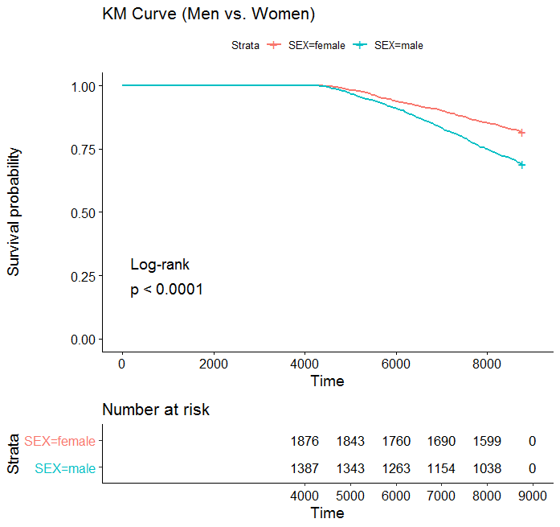
Kaplan Meier
Used when you have a time-to-event outcome
Example
Make your survival object
This KM plot will be using DEATH and stratified by SEX
fit_km <- survfit(Surv(TIMEDTH , DEATH) ~ 1, data = data1)
This KM plot will be using DEATH and stratified by SEX
fit_km1 <- survfit(Surv(TIMEDTH , DEATH) ~ SEX, data = data1)
Make your plot object
p_km <- ggsurvplot(fit_km1, data = data1, risk.table = TRUE,
pval = TRUE,
pval.method = TRUE,
title = "KM Curve (Men vs. Women)")
View your plot
p_km

Slide 24
Cox Model
Used when you have a time-to-event outcome
Example
Make your Cox model object
This is a cox model for DEATH, adjusting for AGE
fit_cox <- coxph(Surv(TIMEDTH , DEATH) ~ AGE, data = data1)
Make your plot object
p_cox <- ggadjustedcurves(fit_cox, data = data1,
title = "Cox PH Curve Adjusted for AGE")
View your plot
p_cox
Make your Cox model object
This is a cox model for DEATH, adjusting for AGE and stratifying by SEX
fit_cox1 <- coxph(Surv(TIMEDTH , DEATH) ~ AGE + strata(SEX) , data = data1)
Make your plot object
p_cox1 <- ggadjustedcurves(fit_cox1, data = data1, variable = "SEX",
title = "Cox PH Curve Adjusted for AGE, strat SEX")
Print your plot
p_cox1

